Slide 1
Introduction to
Artificial Intelligence
Lecture: First Order Logic

Slide 2
Outline
First-Order Logic (FOL)
Unification and Lifting
Forward Chaining
Backward Chaining
Resolution

Slide 3
First-order Logic
Objects are referred by nouns and noun phrases.
E.g., people, houses, numbers, colors, Bill Gates, games, wars, etc.
Relations can be unary relations (properties) or 𝒏-ary relations, representing by verbs and verb phrases
Properties: red, round, prime, etc.
𝑛-ary relations: brother of, bigger than, part of, comes between, etc.
Functions are relations in which there is only one “value” for a given “input.”
E.g., father of, best friend, one more than, etc.

Slide 4
First-order Logic
“One plus two equals three.”
Object: one, two, three, one plus two
Relation: equal
Function: plus
“The intelligent AlphaGo beat the world champion in 2016.”
Object: AlphaGo, world champion, 2016
Property: intelligent
Relation: beat

Slide 5
Types of Logics
Language | Ontological Commitment (What exists in the world) | Epistemological Ontological Commitment (What an agent believes about facts)
Propositional logic | Facts | True/false/unknown
First-order logic | Facts, objects, relations | True/false/unknown
Temporal logic | Facts, objects, relations, time | True/false/unknown
Probability logic | Facts | Degree of belief ∈ [0,1]
Fuzzy logic | Facts with degree of truth ∈ [0,1] | Known interval value

Slide 6
Models for a logic language
Formal structures that constitute the possible worlds under consideration
Each model links the vocabulary of sentences to elements of the possible world → determine the truth of any sentence
Models for propositional logic link proposition symbols to predefined truth values.
The domain of a model is the set of objects (or domain elements) it contains.
Nonempty — Every possible world must contain at least one object

Slide 7
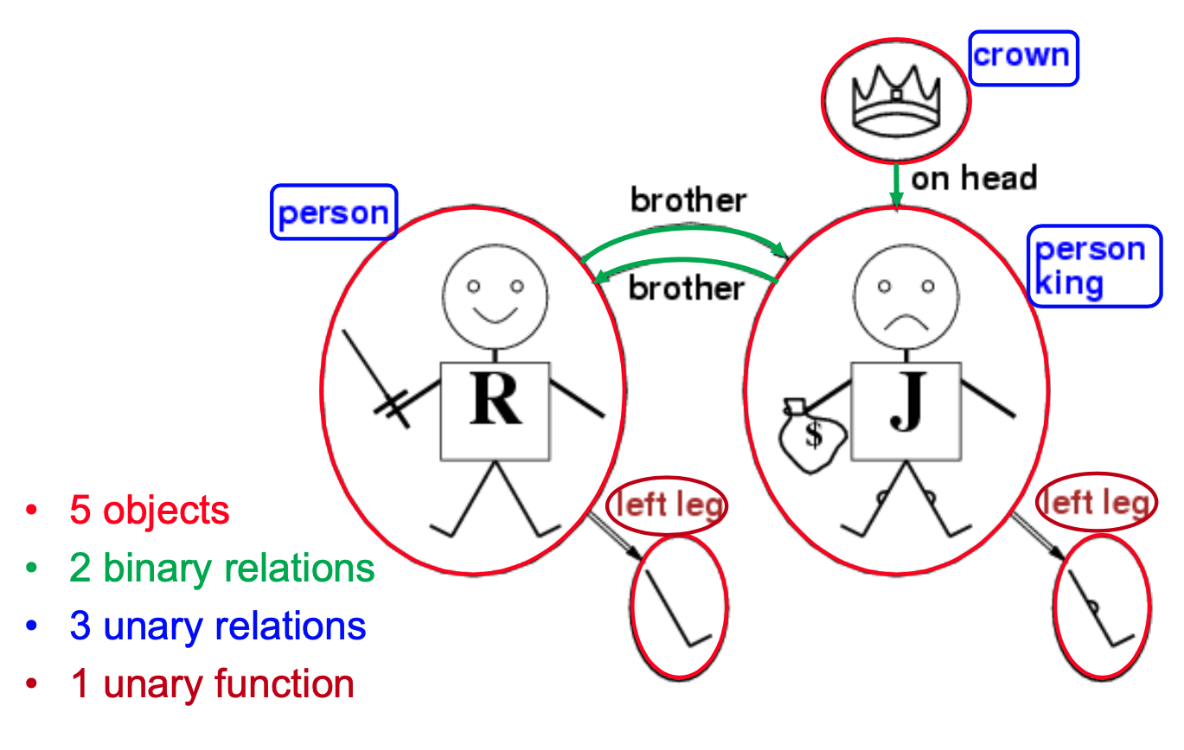
Models for a logic language

Slide 8
Symbols
Constant symbols represents objects.
E.g., Richard, John, etc.
Predicate symbols stand for relations.
E.g., Brother , OnHead, Person, King, and Crown, etc.
Function symbols stand for functions.
E.g., LeftLeg
Each predicate or function symbol comes with an arity that fixes the number of arguments.
E.g., Brother(x,y) → binary, LeftLeg(x) → unary, etc.
These symbols begins with uppercase letters by convention.

Slide 9
Intended interpretation
Interpretation specifies exactly which objects, relations and functions are referred to by the symbol.
Each model includes an (intended) interpretation.

Slide 10
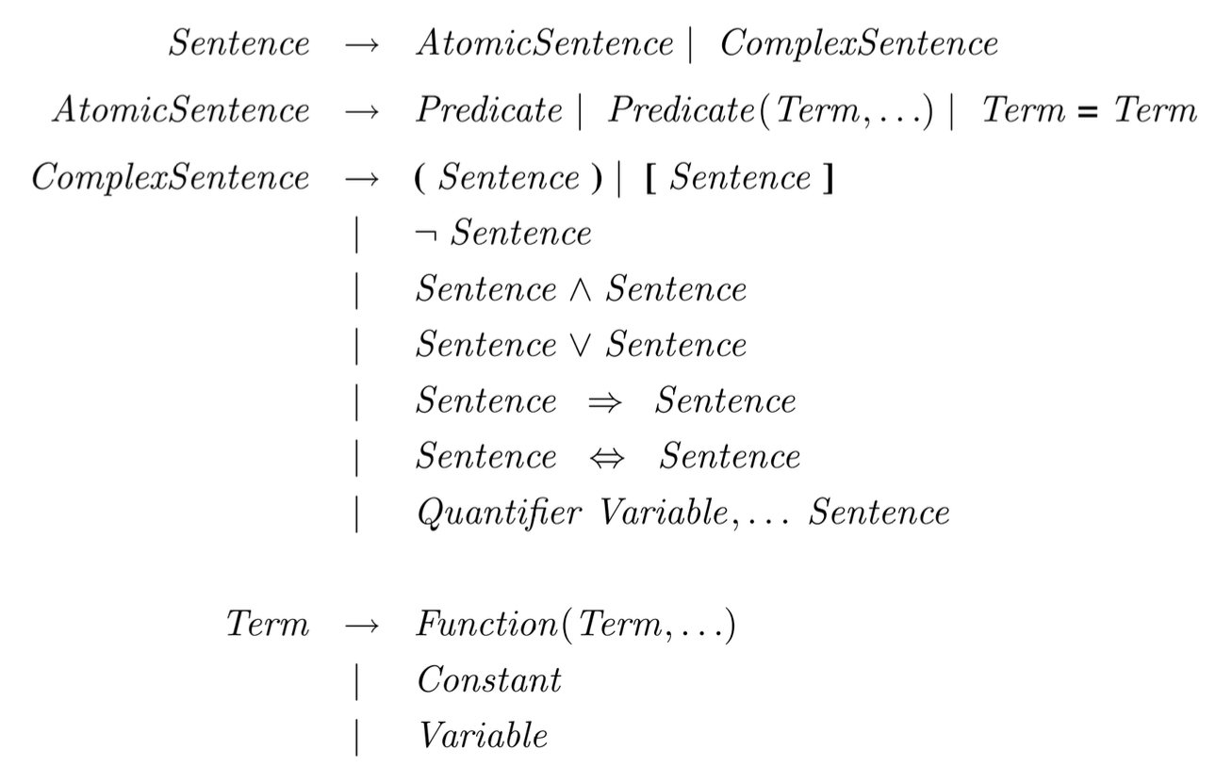
FOL syntax

Slide 11
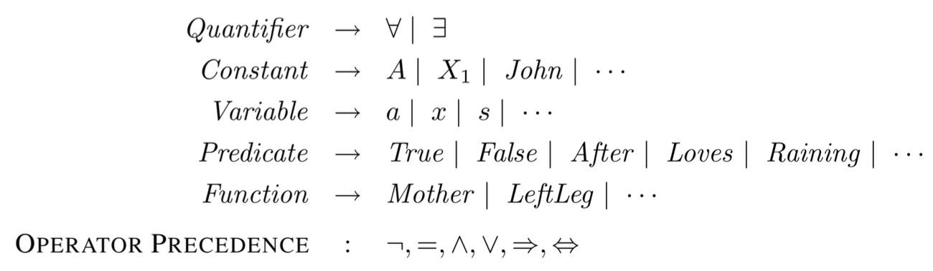
FOL syntax

Slide 12
Terms
A term is a logical expression that refers to an object
Constant symbols: 𝐽𝑜h𝑛
Function symbols: 𝐿𝑒𝑓𝑡𝐿𝑒𝑔(𝐽𝑜h𝑛)
A complex term is formed by a function symbol followed by a parenthesized list of terms as arguments.
Term = function(term₁,...,term_{n}) or constant or variable

Slide 13
Atomic sentence
An atomic sentence state facts by using a predicate symbol followed by a parenthesized list of terms.
Atomic sentence = predicate(term₁,...,term_{n})
For example,
Brother(Richard, John)
Married(Father(Richard), Mother(John))
It is true if the relation referred to by the predicate symbol holds among the objects referred to by the arguments

Slide 14
Complex sentences
A complex sentences are made from atomic sentences using connectives.
For example,
¬𝐵𝑟𝑜𝑡h𝑒𝑟(𝐿𝑒𝑓𝑡𝐿𝑒𝑔(𝑅𝑖𝑐h𝑎𝑟𝑑), 𝐽𝑜h𝑛)
𝐵𝑟𝑜𝑡h𝑒𝑟(𝑅𝑖𝑐h𝑎𝑟𝑑,𝐽𝑜h𝑛) ∧ 𝐵𝑟𝑜𝑡h𝑒𝑟(𝐽𝑜h𝑛,𝑅𝑖𝑐h𝑎𝑟𝑑)
𝐾𝑖𝑛𝑔(𝑅𝑖𝑐h𝑎𝑟𝑑) ∨ 𝐾𝑖𝑛𝑔(𝐽𝑜h𝑛)
¬𝐾𝑖𝑛𝑔(𝑅𝑖𝑐h𝑎𝑟𝑑) ⇒ 𝐾𝑖𝑛𝑔(𝐽𝑜h𝑛)
Syntax and semantics are the same as in propositional logic.

Slide 15
Quantifiers: Universal quantification
∀<variables> <sentence>
E.g., “Students of FIT are smart.”
∀𝑥 𝑆𝑡𝑢𝑑𝑒𝑛𝑡(𝑥, 𝐹𝐼𝑇) ⇒ 𝑆𝑚𝑎𝑟𝑡(𝑥)
∀x P is true in a model m iff P is true with x being each possible object in the model.
It is equivalent to the conjunction of instantiations of 𝑃.
Student(Lan, FIT) ⇒ Smart(Lan) ∧
Student(Tuan, FIT) ⇒ Smart(Tuan) ∧
Student(Long, FIT) ⇒ Smart(Long) ∧ …

Slide 16
Variables
A variable is a term all by itself and able to serve as the argument of a function
E.g., in predicates 𝐾𝑖𝑛𝑔(𝑥) or in function 𝐿𝑒𝑓𝑡𝐿𝑒𝑔(𝑥).
Usually represented by lowercase letters
A term with no variables is called a ground term.

Slide 17
A common mistake to avoid
Typically, ⇒ is the main connective with ∀
The conclusion of the rule just for those objects for whom the premise is true
It says nothing at all about individuals for whom the premise is false.
Too strong implication
∀𝑥 𝑆𝑡𝑢𝑑𝑒𝑛𝑡(𝑥,𝐹𝐼𝑇) ∧ 𝑆𝑚𝑎𝑟𝑡(𝑥)
It means “Everyone is a student of FIT and Everyone is smart.”

Slide 18
Quantifiers: Existential quantification
∃<variables> <sentence>
E.g., “Some students of FIT are smart.”
∃𝑥 𝑆𝑡𝑢𝑑𝑒𝑛𝑡(𝑥,𝐹𝐼𝑇) ∧ 𝑆𝑚𝑎𝑟𝑡(𝑥)
∃x P is true in a model m iff P is true with x being some possible object in the model.
It is equivalent to the disjunction of instantiations of 𝑃.
Student(Lan, FIT) ∧ Smart(Lan) ∨
Student(Tuan, FIT) ∧ Smart(Tuan) ∨
Student(Long, FIT) ∧ Smart(Long) ∨ ...

Slide 19
Common mistake to avoid
Typically, ∧ is the main connective with ∃
Too weak implication
∃𝑥 𝑆𝑡𝑢𝑑𝑒𝑛𝑡(𝑥, 𝐹𝐼𝑇) ⇒ 𝑆𝑚𝑎𝑟𝑡(𝑥)
It is true even with anyone who is not at FIT.

Slide 20
Nested quantifiers
Multiple quantifiers enable more complex sentences.
Simplest cases: Quantifiers are of the same type
∀𝑥∀𝑦 𝐵𝑟𝑜𝑡h𝑒𝑟 𝑥, 𝑦 ⇒ 𝑆𝑖𝑏𝑙𝑖𝑛𝑔(𝑥, 𝑦)
∀𝑥∀𝑦 𝑆𝑖𝑏𝑙𝑖𝑛𝑔(𝑥, 𝑦) ⇔ 𝑆𝑖𝑏𝑙𝑖𝑛𝑔(𝑦, 𝑥)
Mixtures
∀𝑥∃𝑦 𝐿𝑜𝑣𝑒𝑠(𝑥, 𝑦) → “Everybody loves somebody.”
∃𝑥∀𝑦 𝐿𝑜𝑣𝑒𝑠(𝑦, 𝑥) → “There is someone loved by everyone.”
The order of quantification is therefore very important.

Slide 21
Nested quantifiers
Rule: The variable belongs to the innermost quantifier that mentions it.
∀𝑥 (𝐶𝑟𝑜𝑤𝑛(𝑥) ∨ (∃𝑥 𝐵𝑟𝑜𝑡h𝑒𝑟(𝑅𝑖𝑐h𝑎𝑟𝑑, 𝑥))
Workaround: Use different variable names with nested quantifier, e.g., ∃𝑧 𝐵𝑟𝑜𝑡h𝑒𝑟(𝑅𝑖𝑐h𝑎𝑟𝑑, 𝑧)

Slide 22
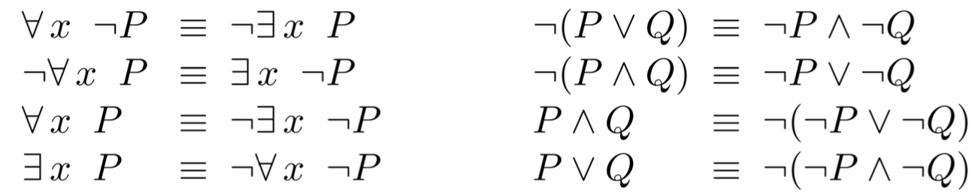
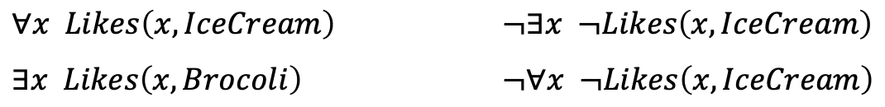
Quantifier duality
De Morgan’s rules
For example

Slide 23
Equality symbol =
𝑡𝑒𝑟𝑚1 = 𝑡𝑒𝑟𝑚2 is true under a given interpretation iff 𝑡𝑒𝑟𝑚1 and 𝑡𝑒𝑟𝑚2 refer to the same object
The negation insists that two terms are not the same.
∃𝑥, 𝑦 𝐵𝑟𝑜𝑡h𝑒𝑟(𝑥, 𝑅𝑖𝑐h𝑎𝑟𝑑) ∧ 𝐵𝑟𝑜𝑡h𝑒𝑟(𝑦, 𝑅𝑖𝑐h𝑎𝑟𝑑) ∧ ¬(𝑥 = 𝑦)

Slide 24
Practise
∀𝑚, 𝑐 𝑀𝑜𝑡h𝑒𝑟(𝑐) = 𝑚 ⇔ 𝐹𝑒𝑚𝑎𝑙𝑒(𝑚) ∧ 𝑃𝑎𝑟𝑒𝑛𝑡(𝑚, 𝑐)
∀𝑤, h 𝐻𝑢𝑠𝑏𝑎𝑛𝑑(h, 𝑤) ⇔ 𝑀𝑎𝑙𝑒(h) ∧ 𝑆𝑝𝑜𝑢𝑠𝑒(h, 𝑤)
∀𝑥 𝑀𝑎𝑙𝑒(𝑥) ⇔ ¬𝐹𝑒𝑚𝑎𝑙𝑒(𝑥)
∀𝑝,𝑐 𝑃𝑎𝑟𝑒𝑛𝑡(𝑝,𝑐) ⇔ 𝐶h𝑖𝑙𝑑(𝑐,𝑝)
∀𝑔, 𝑐 𝐺𝑟𝑎𝑛𝑑𝑝𝑎𝑟𝑒𝑛𝑡(𝑔, 𝑐) ⇔ ∃𝑝 𝑃𝑎𝑟𝑒𝑛𝑡(𝑔, 𝑝) ∧ 𝑃𝑎𝑟𝑒𝑛𝑡(𝑝, 𝑐)
∀𝑥, 𝑦 𝑆𝑖𝑏𝑙𝑖𝑛𝑔(𝑥, 𝑦) ⇔ ¬(𝑥 = 𝑦) ∧ ∃𝑝 𝑃𝑎𝑟𝑒𝑛𝑡(𝑝, 𝑥) ∧ 𝑃𝑎𝑟𝑒𝑛𝑡(𝑝, 𝑦)

Slide 25
Practise
Diagnostic rule → infer cause from effect
∀𝑠 𝐵𝑟𝑒𝑒𝑧𝑦(𝑠) ⇔ ∃𝑟 𝐴𝑑𝑗𝑎𝑐𝑒𝑛𝑡(𝑟, 𝑠) ∧ 𝑃𝑖𝑡(𝑟)
Causal rule → infer effect from cause
∀𝑟 𝑃𝑖𝑡(𝑟) ⇔ [∀𝑠 𝐴𝑑𝑗𝑎𝑐𝑒𝑛𝑡(𝑟, 𝑠) ⇒ 𝐵𝑟𝑒𝑒𝑧𝑦(𝑠)]

Slide 26
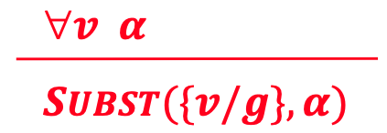
Universal Instantiation (UI)
It is possible to infer any sentence obtained by substituting a ground term for the variable.
Let 𝑆𝑈𝐵𝑆𝑇(𝜃, 𝛼) be the result of applying the substitution 𝜃 to the sentence 𝛼.
Then the rule of Universal Instantiation is written

Slide 27
Universal Instantiation (UI)
∀𝒙 𝑲𝒊𝒏𝒈 𝒙 ∧ 𝑮𝒓𝒆𝒆𝒅𝒚(𝒙) ⇒ 𝑬𝒗𝒊𝒍(𝒙)
𝐾𝑖𝑛𝑔(𝐽𝑜h𝑛) ∧ 𝐺𝑟𝑒𝑒𝑑𝑦(𝐽𝑜h𝑛) ⇒ 𝐸𝑣𝑖𝑙(𝐽𝑜h𝑛)
𝐾𝑖𝑛𝑔(𝑅𝑖𝑐h𝑎𝑟𝑑) ∧ 𝐺𝑟𝑒𝑒𝑑𝑦(𝑅𝑖𝑐h𝑎𝑟𝑑) ⇒ 𝐸𝑣𝑖𝑙(𝑅𝑖𝑐h𝑎𝑟𝑑)
𝐾𝑖𝑛𝑔(𝐹𝑎𝑡h𝑒𝑟(𝐽𝑜h𝑛)) ∧ 𝐺𝑟𝑒𝑒𝑑𝑦(𝐹𝑎𝑡h𝑒𝑟(𝐽𝑜h𝑛)) ⇒ 𝐸𝑣𝑖𝑙(𝐹𝑎𝑡h𝑒𝑟(𝐽𝑜h𝑛))
substitutions: {𝑥/𝐽𝑜h𝑛}, {𝑥/𝑅𝑖𝑐h𝑎𝑟𝑑}, {𝑥/𝐹𝑎𝑡h𝑒𝑟(𝐽𝑜h𝑛)}

Slide 28
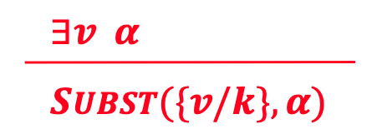
Existential Instantiation (EI)
It is possible to replace the variable by a single new constant symbol.
The rule of Existential Instantiation is written
for any sentence 𝛼, variable 𝑣, and constant symbol 𝑘 that does not appear elsewhere in 𝐾𝐵.
𝐶𝑟𝑜𝑤𝑛(𝐶) ∧ 𝑂𝑛𝐻𝑒𝑎𝑑(𝐶, 𝐽𝑜h𝑛)
𝐶 does not appear in 𝐾𝐵 → Skolem constant.

Slide 29
Universal / Existential Instantiation
The UI rule can be applied many times to produce different consequences.
The EI rule can be applied once, and then the existentially quantified sentence is discarded.
The new 𝐾𝐵 is not logically equivalent to the old but shown to be inferentially equivalent.

Slide 30
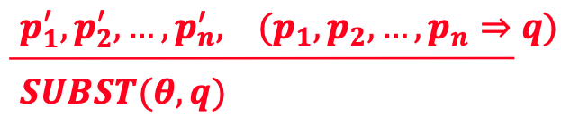
Generalized Modus Ponens (GMP)
For atomic sentences 𝑝_{i}, 𝑝_{i}′ and 𝑞, where there exists 𝜃 such that 𝑆𝑈𝐵𝑆𝑇(𝜃, 𝑝_{i}′) = 𝑆𝑈𝐵𝑆𝑇(𝜃, 𝑝_{i}), for all 𝑖
For example, 𝑝₁′ is 𝐾𝑖𝑛𝑔(𝐽𝑜h𝑛) 𝑝₁ is 𝐾𝑖𝑛𝑔(𝑥)
𝑝₂′ is 𝐺𝑟𝑒𝑒𝑑𝑦(𝑦) 𝑝₂ is 𝐺𝑟𝑒𝑒𝑑𝑦(𝑥)
𝜃 is {𝑥/𝐽𝑜h𝑛, 𝑦/𝐽𝑜h𝑛} 𝑞 is 𝐸𝑣𝑖𝑙(𝑥)
𝑆𝑈𝐵𝑆𝑇(𝜃, 𝑞) is 𝐸𝑣𝑖𝑙(𝐽𝑜h𝑛)
All variables assumed universally quantified
A lifted version of Modus Ponens → sound inference rule

Slide 31
Unification
Find substitutions that make different logical expressions look identical
𝑼𝑵𝑰𝑭𝒀(𝒑, 𝒒) = 𝜽 where 𝑆𝑈𝐵𝑆𝑇(𝜃, 𝑝) = 𝑆𝑈𝐵𝑆𝑇(𝜃, 𝑞)
For example,
Standardizing apart eliminates overlap of variables:
Knows(z, Steve)
p | q | 𝜃
Knows(John, x) | Knows(John, Jane) | {x/Jane}
Knows(John, x) | Knows(y, Steve) | {x/Steve, y/John}
Knows(John, x) | Knows(y, Mother(y)) | {x/Mother(John), y/John}
Knows(John, x) | Knows(x, Steve) | fail

Slide 32
Most General Unifier (MGU)
𝑈𝑁𝐼𝐹𝑌(𝐾𝑛𝑜𝑤𝑠(𝐽𝑜h𝑛, 𝑥), 𝐾𝑛𝑜𝑤𝑠(𝑦, 𝑧)) = 𝜃
1. 𝜃 = {𝑦/𝐽𝑜h𝑛, 𝑥/𝑧 }
2. 𝜃 = {𝑦/𝐽𝑜h𝑛, 𝑥/𝐽𝑜h𝑛, 𝑧/𝐽𝑜h𝑛}
The first unifier is more general than the second
There is a single Most General Unifier (MGU) that is unique up to renaming of variables.
𝑀𝐺𝑈 = {𝑦/𝐽𝑜h𝑛, 𝑥/𝑧}

Slide 33
Unification algorithm
function UNIFY(x , y, θ) returns a substitution to make x and y identical
inputs: x , a variable, constant, list, or compound expression
y, a variable, constant, list, or compound expression
θ, the substitution built up so far (optional, defaults to empty)
if θ = failure then return failure
else if x = y then return θ
else if VARIABLE?(x) then return UNIFY-VAR(x , y, θ)
else if VARIABLE?(y) then return UNIFY-VAR(y, x , θ)
else if COMPOUND?(x) and COMPOUND?(y) then
return UNIFY(x.ARGS, y.ARGS, UNIFY(x.OP, y.OP, θ))
else if LIST?(x) and LIST?(y) then
return UNIFY(x.REST, y.REST, UNIFY(x.FIRST, y.FIRST, θ))
else return failure

Slide 34
Unification algorithm
function UNIFY-VAR(var, x , θ) returns a substitution
if {var /val} ∈ θ then
return UNIFY(val, x , θ)
else if {x/val} ∈ θ then
return UNIFY(var, val, θ)
else if OCCUR-CHECK?(var, x) then
return failure
else return add {var/x} to θ

Slide 35
Forward Chaining
A definite clause is a disjunctions of literals of which exactly one is positive.
First-order literals can include variables, which are assumed to be universally quantified.
Not every 𝐾𝐵 can be converted into a set of definite clauses due to the single-positive-literal restriction.

Slide 36
Forward Chaining
“The law says that it is a crime for an American to sell weapons to hostile nations. The country Nono, an enemy of America, has some missiles, and all of its missiles were sold to it by Colonel West, who is American.”
𝐴𝑚𝑒𝑟𝑖𝑐𝑎𝑛(𝑥) ∧ 𝑊𝑒𝑎𝑝𝑜𝑛(𝑦) ∧ 𝑆𝑒𝑙𝑙𝑠(𝑥, 𝑦, 𝑧) ∧ 𝐻𝑜𝑠𝑡𝑖𝑙𝑒(𝑧) ⇒ 𝐶𝑟𝑖𝑚𝑖𝑛𝑎𝑙(𝑥)
∃𝑥 𝑂𝑤𝑛𝑠(𝑁𝑜𝑛𝑜, 𝑥) ∧ 𝑀𝑖𝑠𝑠𝑖𝑙𝑒(𝑥)
𝑂𝑤𝑛𝑠(𝑁𝑜𝑛𝑜,𝑀₁)
𝑀𝑖𝑠𝑠𝑖𝑙𝑒(𝑀₁)
𝑀𝑖𝑠𝑠𝑖𝑙𝑒(𝑥) ∧ 𝑂𝑤𝑛𝑠(𝑁𝑜𝑛𝑜, 𝑥) ⇒ 𝑆𝑒𝑙𝑙𝑠(𝑊𝑒𝑠𝑡, 𝑥, 𝑁𝑜𝑛𝑜)
𝑀𝑖𝑠𝑠𝑖𝑙𝑒(𝑥) ⇒ 𝑊𝑒𝑎𝑝𝑜𝑛(𝑥) 𝐴𝑚𝑒𝑟𝑖𝑐𝑎𝑛(𝑊𝑒𝑠𝑡)
𝐸𝑛𝑒𝑚𝑦(𝑥,𝐴𝑚𝑒𝑟𝑖𝑐𝑎) ⇒ 𝐻𝑜𝑠𝑡𝑖𝑙𝑒(𝑥) 𝐸𝑛𝑒𝑚𝑦(𝑁𝑜𝑛𝑜, 𝐴𝑚𝑒𝑟𝑖𝑐𝑎)

Slide 37
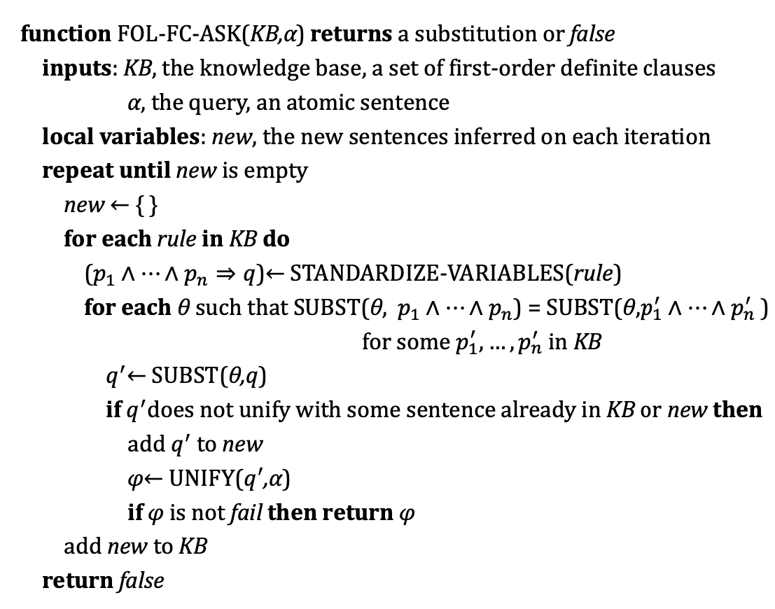
Forward Chaining

Slide 38
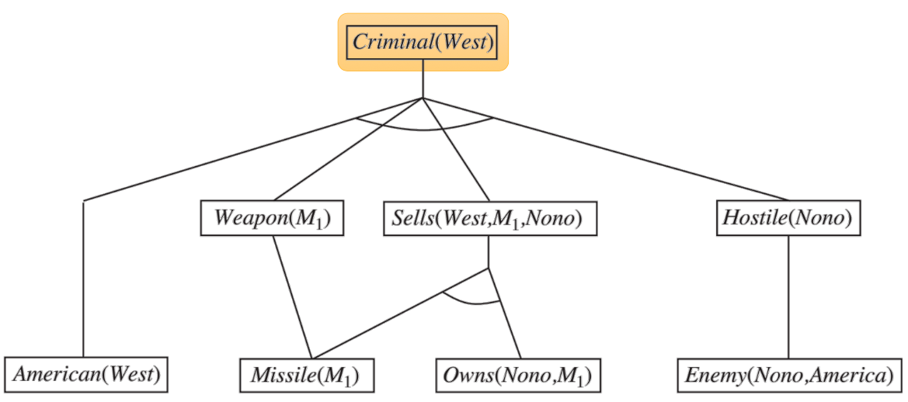
Forward Chaining

Slide 39
Forward Chaining
Soundness?
YES, every inference is just an application of GMP.
Completeness?
YES for definite clause knowledge bases.
It answers every query whose answers are entailed by any 𝐾𝐵 of definite clauses.
Terminate for Datalog in finite number of iterations
Datalog = first-order definite clauses + no functions
Entailment with definite clauses is semidecidable.

Slide 40
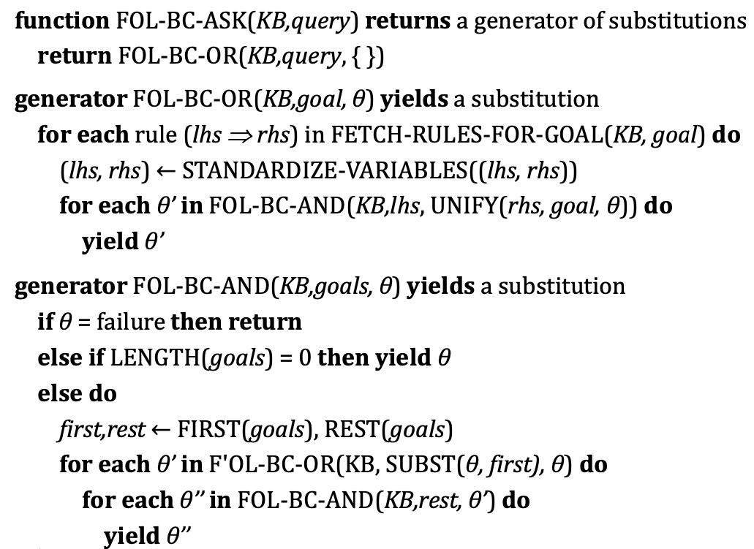
Backward chaining

Slide 41
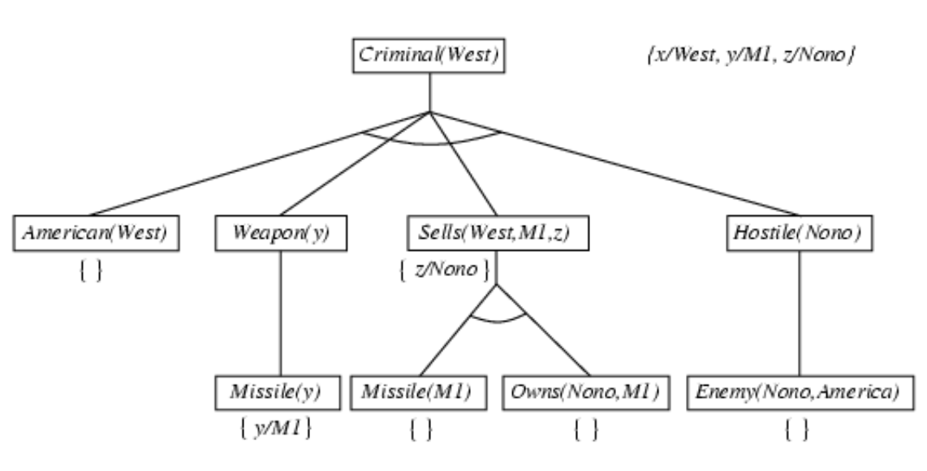
Backward chaining

Slide 42
Backward chaining
Depth-first recursive proof search
Space is linear in size of proof
Incomplete due to infinite loops
Fix by checking current goal against every goal on stack
Inefficient due to repeated subgoals (success and failure)
Fix using caching of previous results (extra space)
Widely used for logic programming

Slide 43
CNF for First-order logic
First-order resolution requires that sentences be in CNF
Every sentence of first-order logic can be converted into an inferentially equivalent CNF sentence.
For example, the sentence
∀𝑥 𝐴𝑚𝑒𝑟𝑖𝑐𝑎𝑛(𝑥) ∧ 𝑊𝑒𝑎𝑝𝑜𝑛(𝑦) ∧ 𝑆𝑒𝑙𝑙𝑠(𝑥, 𝑦, 𝑧)
∧ 𝐻𝑜𝑠𝑡𝑖𝑙𝑒(𝑧) ⇒ 𝐶𝑟𝑖𝑚𝑖𝑛𝑎𝑙(𝑥)
becomes, in CNF,
¬𝐴𝑚𝑒𝑟𝑖𝑐𝑎𝑛(𝑥) ∨ ¬𝑊𝑒𝑎𝑝𝑜𝑛(𝑦) ∨ ¬𝑆𝑒𝑙𝑙𝑠(𝑥, 𝑦, 𝑧)
∨ ¬𝐻𝑜𝑠𝑡𝑖𝑙𝑒(𝑧) ∨ 𝐶𝑟𝑖𝑚𝑖𝑛𝑎𝑙(𝑥)

Slide 44
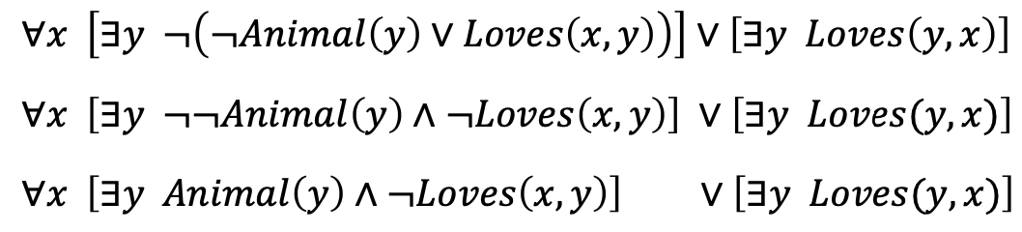
Conversion to CNF
Eliminate implications
Move ¬ in wards: ¬∀𝑥 𝑝≡ ∃𝑥 ¬𝑝, ¬∃𝑥 𝑝 ≡ ∀𝑥 ¬𝑝
Standardize variables:each quantifier uses a different one

Slide 45
Conversion to CNF
Skolemize: remove existential quantifiers by elimination
Simple case: translate ∃𝑥 𝑃(𝑥) into 𝑃(𝐴), where 𝐴 is a new constant.
However, ∀𝑥 [𝐴𝑛𝑖𝑚𝑎𝑙(𝐴) ∧ ¬𝐿𝑜𝑣𝑒𝑠(𝑥, 𝐴)] ∨ 𝐿𝑜𝑣𝑒𝑠(𝐵, 𝑥) has an entirely different meaning.
The arguments of the Skolem function are all universally quantified variables in whose scope the existential quantifier appears.
Drop universal quantifiers

Slide 46
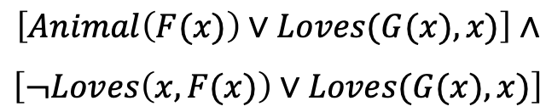
Conversion to CNF
Distribute ∨ over ∧

Slide 47
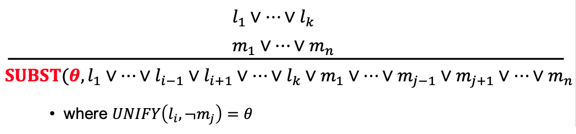
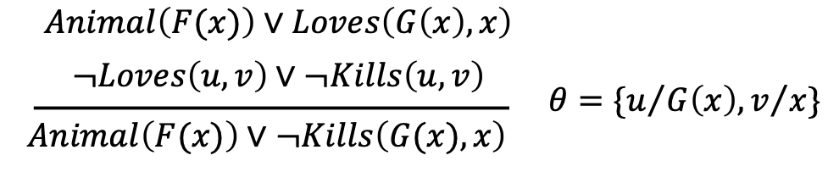
Resolution
For example,

Slide 48
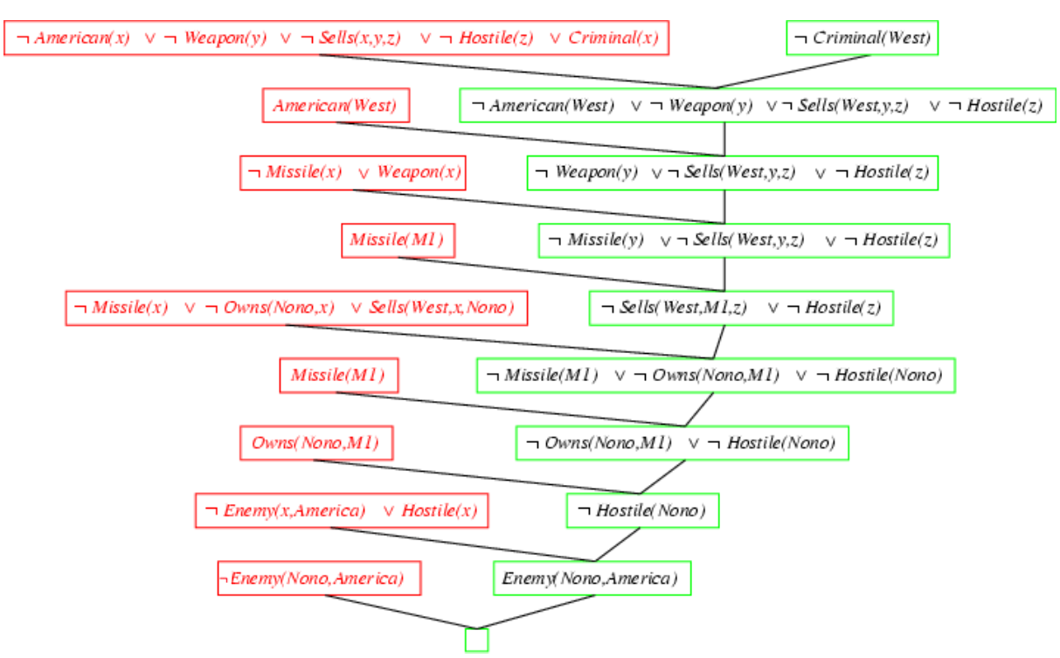
Resolution

Slide 49
References
Stuart Russell and Peter Norvig. 2009. Artificial Intelligence: A Modern Approach (3rd ed.). Prentice Hall Press, Upper Saddle River, NJ, USA.
Lê Hoài Bắc, Tô Hoài Việt. 2014. Giáo trình Cơ sở Trí tuệ nhân tạo. Khoa Công nghệ Thông tin. Trường ĐH Khoa học Tự nhiên, ĐHQG-HCM.
Nguyễn Ngọc Thảo, Nguyễn Hải Minh. 2020. Bài giảng Cơ sở Trí tuệ Nhân tạo. Khoa Công nghệ Thông tin. Trường ĐH Khoa học Tự nhiên, ĐHQG-HCM.

